Slide 1

INSURANCE POLICY MANAGEMENT (group 8 RLL)

Slide 2
Team Members:
EMPLOYEE ID | EMPLOYEE NAME
2567378 | Obulareddy Ganga Dinesh Reddy
2568039 | Potti Venkata Satya Sai Penchala Dinesh
2568633 | Samrudh Kadabi
2567793 | Shaik Ashiq
2568013 | Suchit Kumar
2566998 | Ullegadda Meghana
2567521 | Yanamala Priyanka
2568002 | Maheswari Eemani
2568610 | Pavithra Asokan

Slide 3
Index
Introduction
Project Scope
Tools and Technologies
Existing System
Proposed System
Flowchart
Admin Module
Admin ER Diagram
User Module
User ER Diagram
Output
Advantages
Future Scope
Conclusion

Slide 4
Introduction:
IPM System is a web application which is used to track the details about the insurance policies, customer details and company details. It is the end-to-end process of handling insurance services.
The purpose of this IPM System is to automate the existing manual system by the help of computerized equipments and full-fledged computer software, fulfilling their requirements, so that their data/information can be stored for a longer period with easy accessing and manipulation of the same.
It is build to provide a secure and bug-free application to the admin as well as the customer.
It maintains the record of customers, policies, buyers’ policies efficiently so that it would be easy to access at any time 24*7.

Slide 5
Project Scope
Granting security to people.
Minimization of losses.
Diversifying the risk.
Covers term insurance.
To increase the habit of long term savings.
To offer income protection even while employed.
To safeguard the rights and interest of the insuring people.

Slide 6
Tools and Technologies:
Front-End: Angular
Server-side: Spring Boot
Back-End: MYSQL, Hibernate
Server: Tomcat

Slide 7
Existing System:
In the existing system, customers required to physically visit insurance offices or rely on postal services for communication. This can be inconvenient for individuals who prefer or need immediate access to policy information and services.
The flow of an offline insurance policy system typically involves a series of manual and paper-based processes. Paper-based processes in offline systems are typically slower than digital ones. This can result in delays in policy issuance, claims processing, and customer service responses, which can be frustrating for customers.
Offline systems can lead to data inefficiencies and errors due to manual data entry and paperwork handling. This increases the risk of inaccuracies in policy details and claims processing.
High cost, relying on agents or customer service representatives for policy updates, changes and inquiries, security concerns etc...

Slide 8
Proposed System:
The proposed system is to automate that the policies can be applied through online efficiently, conveniently and flexibly.
This IPM system majorly contains two roles:
1. Admin
2. Customer
Admin can add, view, update, delete, approve the policy applies by the customer, he’ll also be able to answer the queries asked by the customers.
A customer can add and update his account, can view the policies that are added by the admin and the customer can apply for the policy if she/he likes it, the customer can also be able to ask queries to the admin.
Finally, the proposed system is accessible 24/7 from anywhere with an internet connection, allowing policyholders to review policy information, make payments, and initiate changes at their convenience, without the need to visit a physical office.

Slide 9
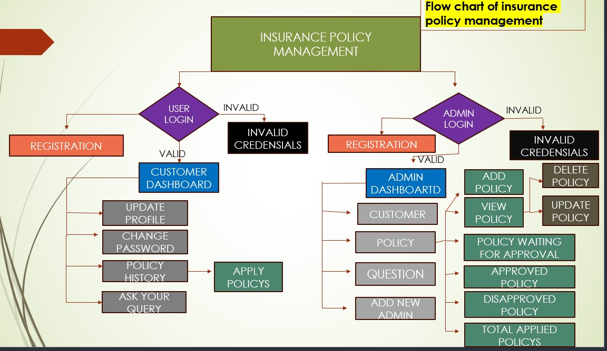
Flowchart

Slide 10
Admin Module:
Login to the portal
Create Admin Account
View/Delete customer.
View/Add/Update/Delete policy category like Life, Health, Motor, Travel
View/Add/Update/Delete /Approve policy.
View total policy holder, approved policy holder, disapproved policy holder.
Approve policy, applied by customer.8.Answer customer question

Slide 11
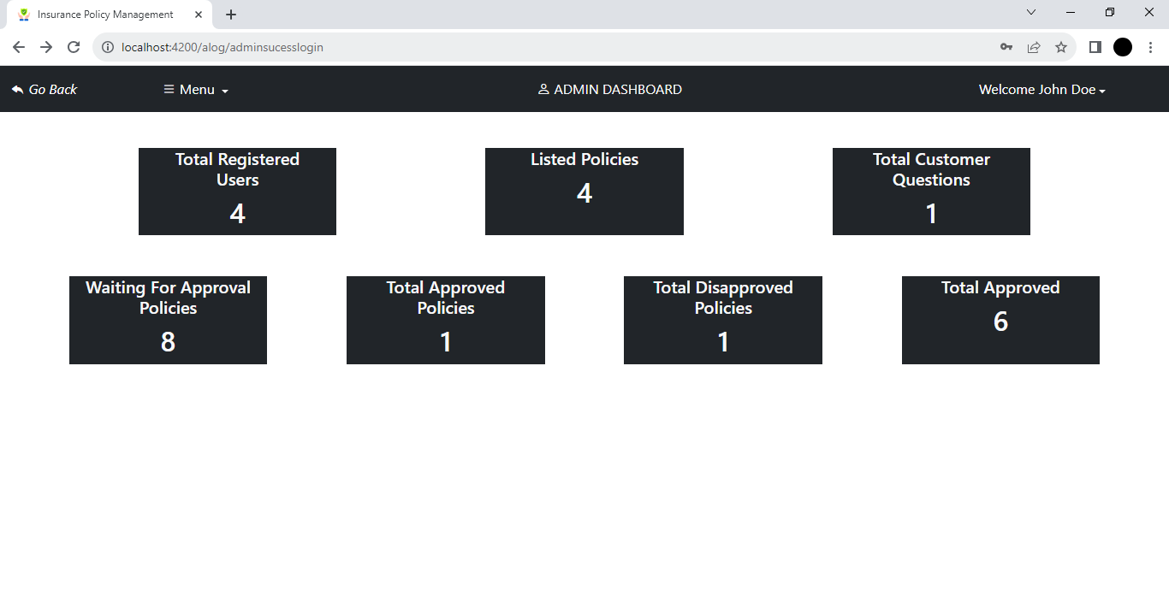
Admin Dashboard

Slide 12
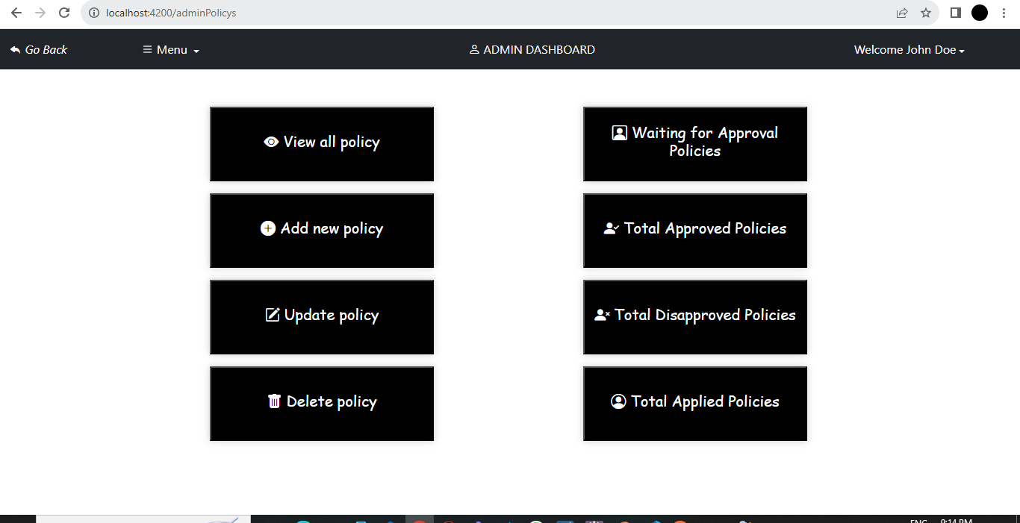

Slide 13
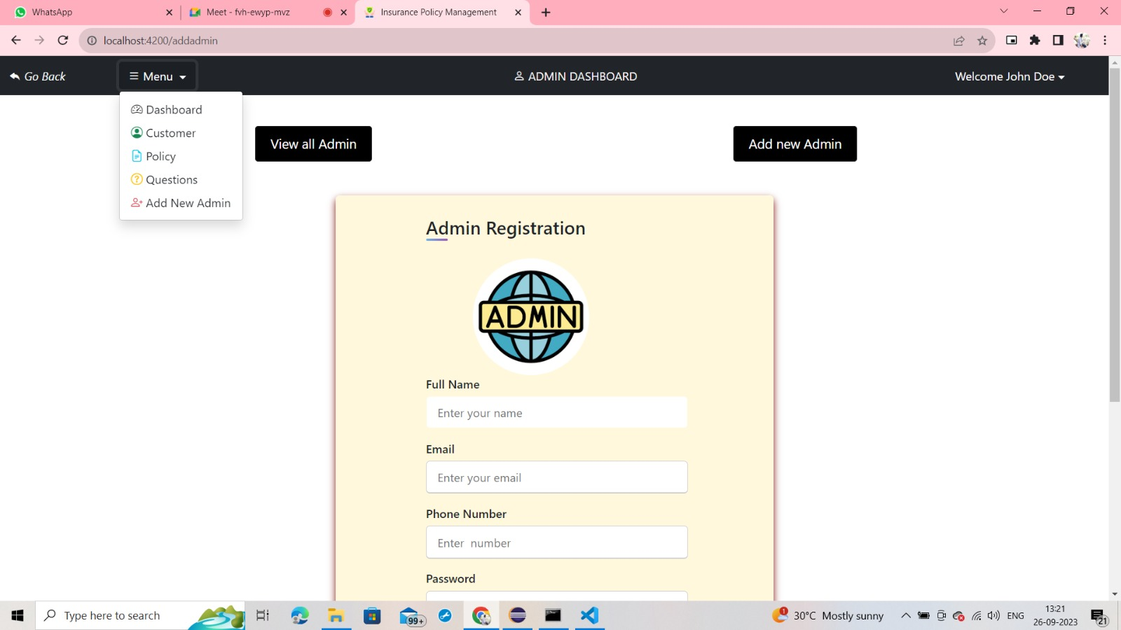

Slide 14
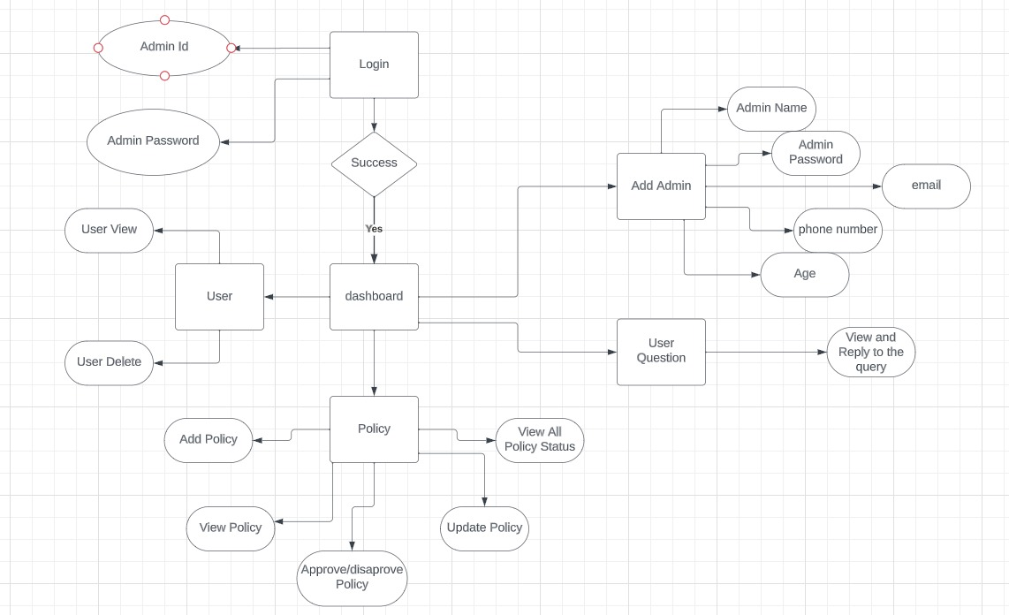
Admin ER Diagram

Slide 15
User Module:
Create account (no approval required by admin)
Change the password.
Change address, email, mobile.
View all policy that are added by admin.
If customer likes any policy, then they can apply for it.
When customer applies for any policy, it will go into pending status, admin can approve it.
Customer can check status of his policy under history section.
Customer can ask question from admin.

Slide 16
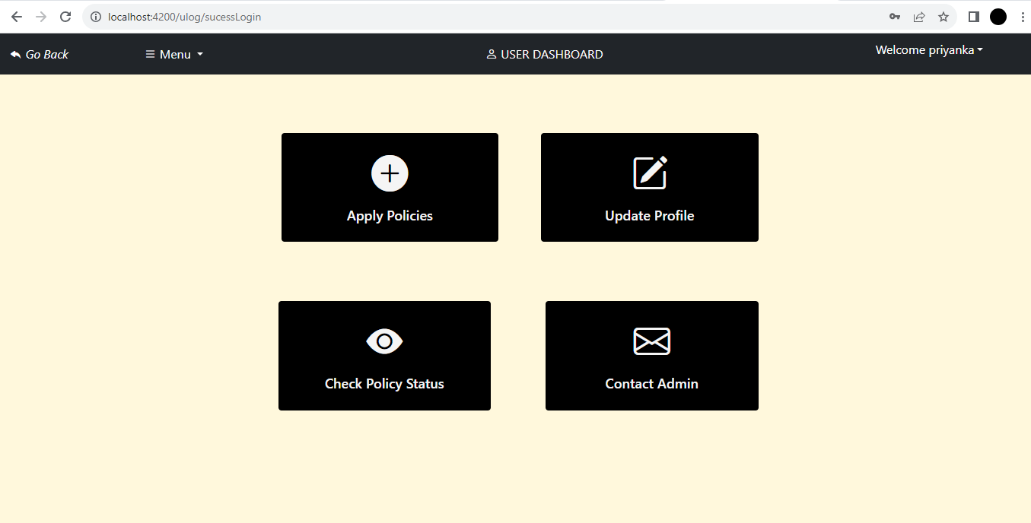
User Dashboard

Slide 17
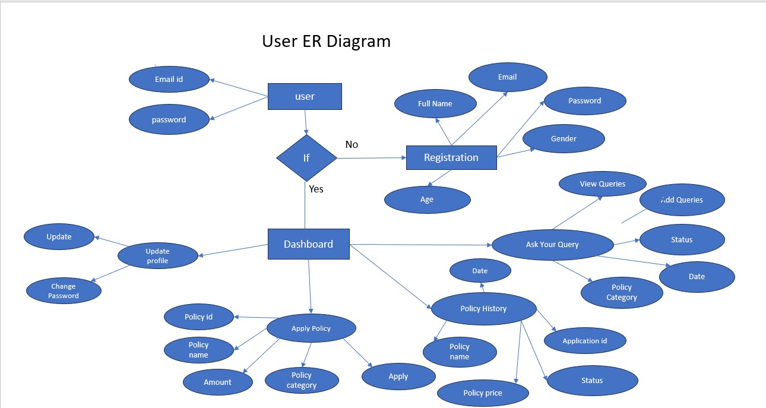
User ER Diagram

Slide 18
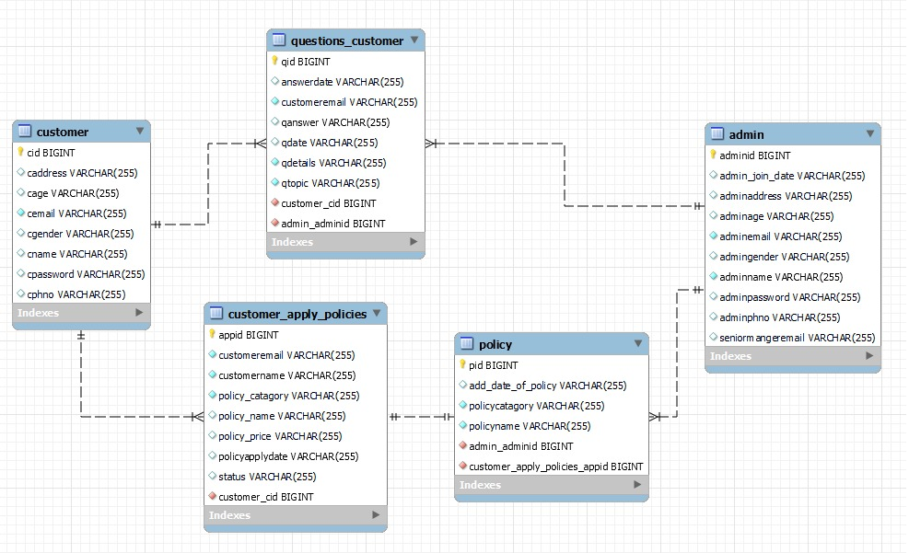
DB Schema

Slide 19
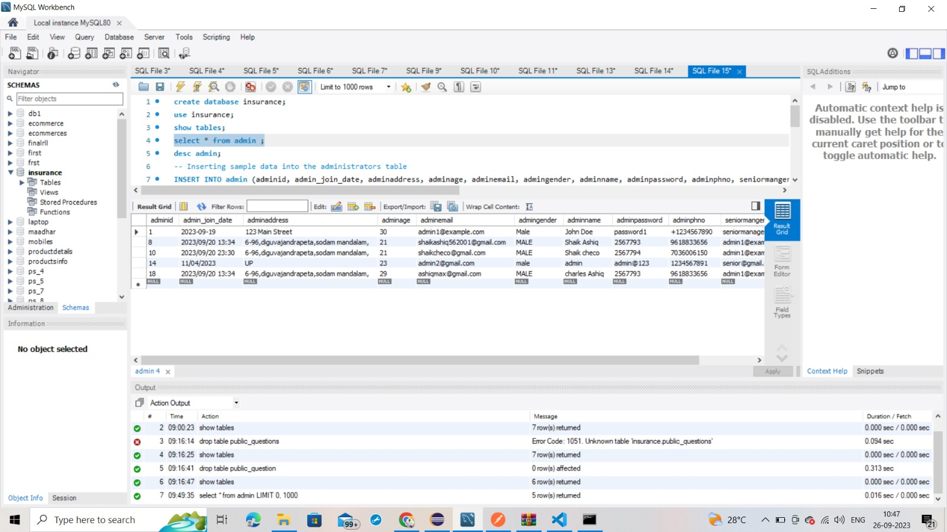
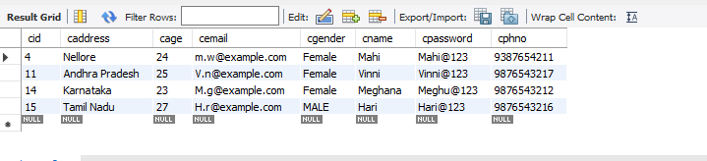
Database Tables

Slide 20
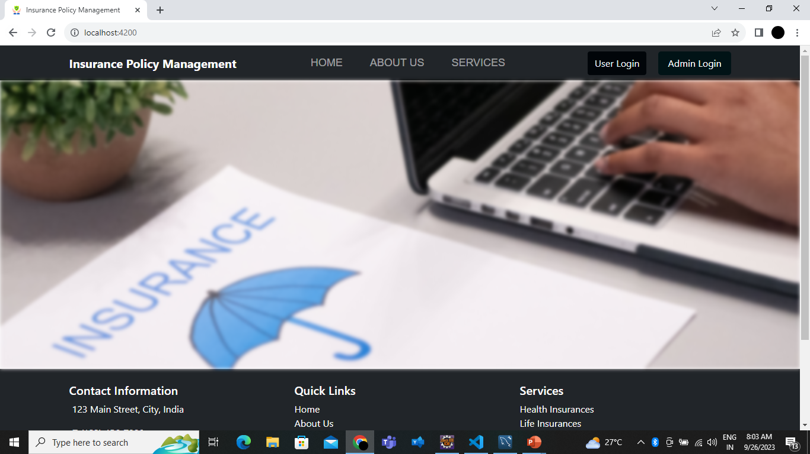
Output: Home page

Slide 21
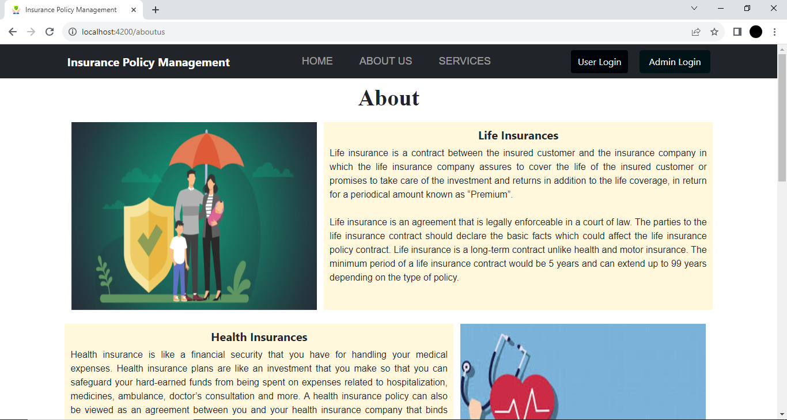
About us

Slide 22
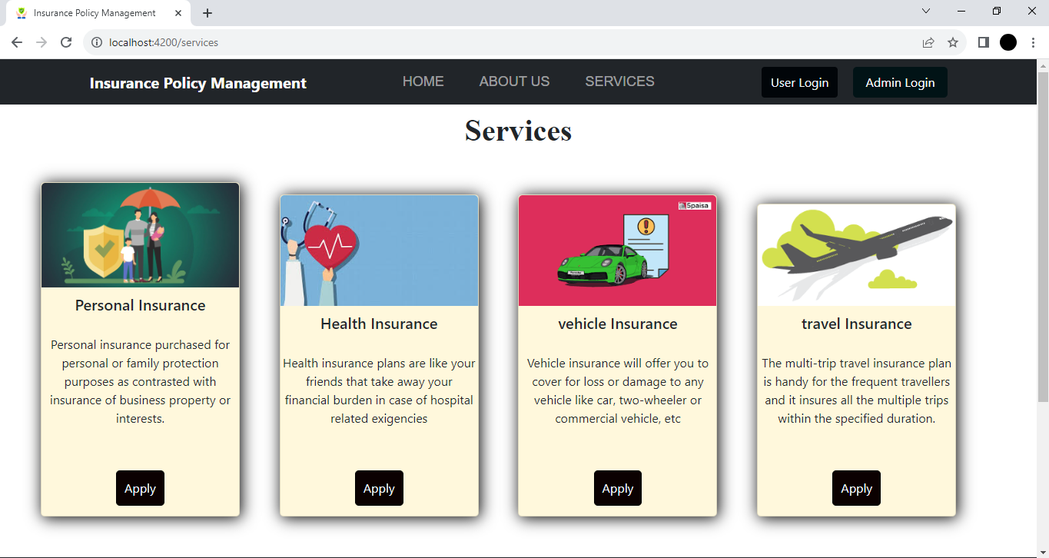
Services

Slide 23
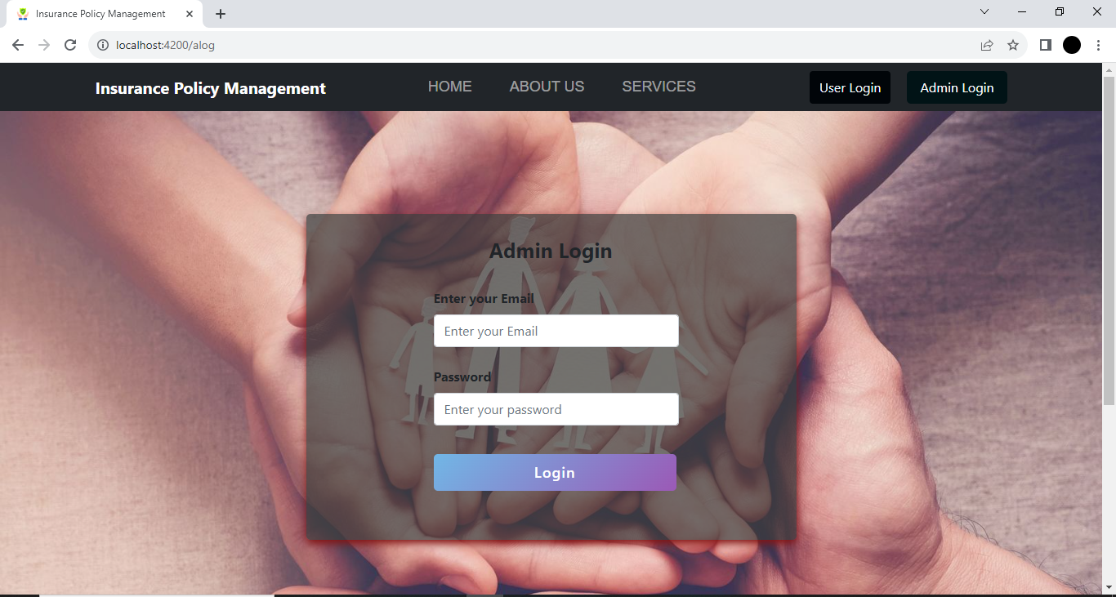
Admin Login Page

Slide 24
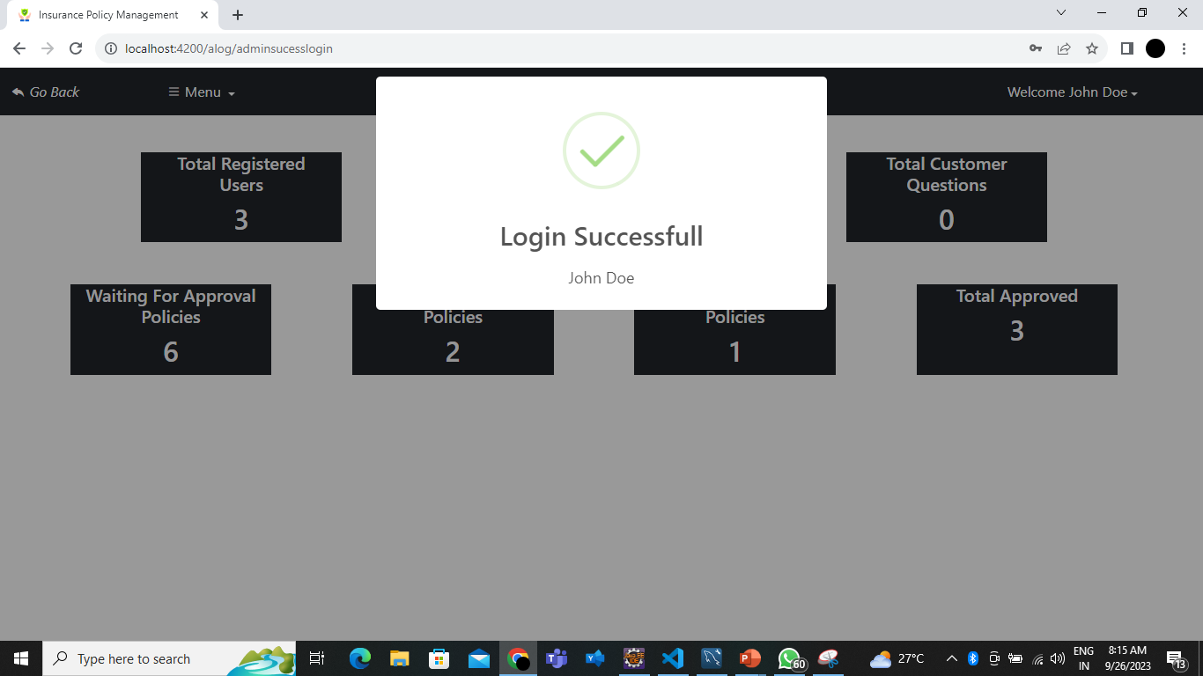
Admin Successful Login

Slide 25
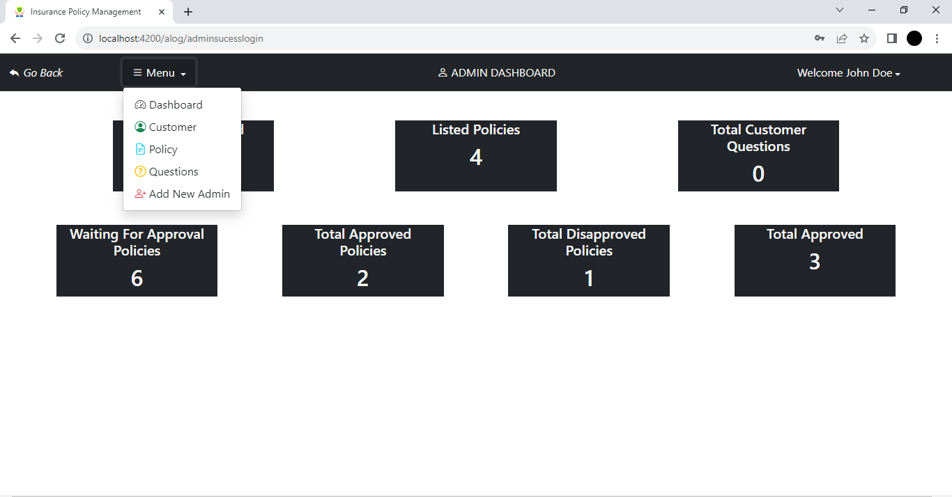
Admin Dashboard

Slide 26
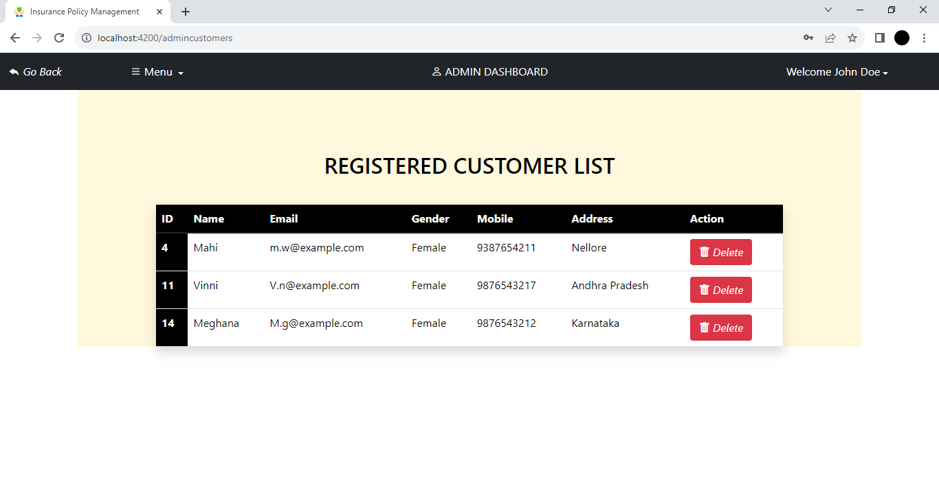
Registered Customer List

Slide 27
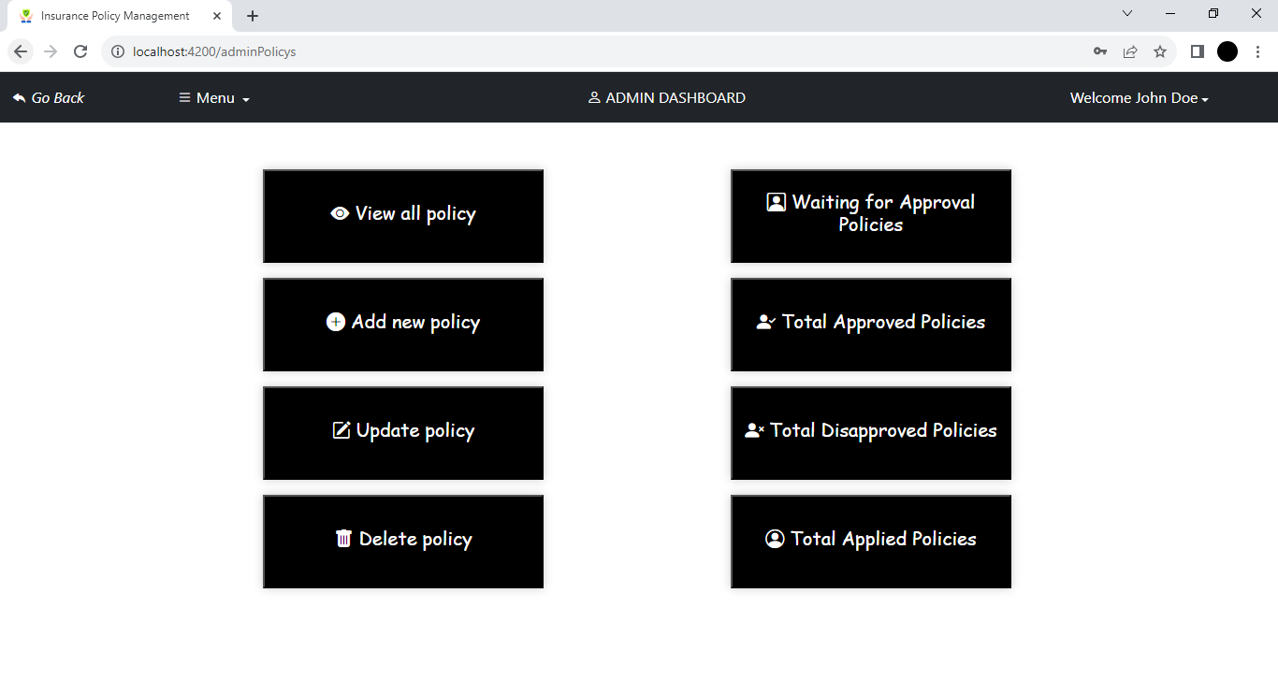
Policy

Slide 28
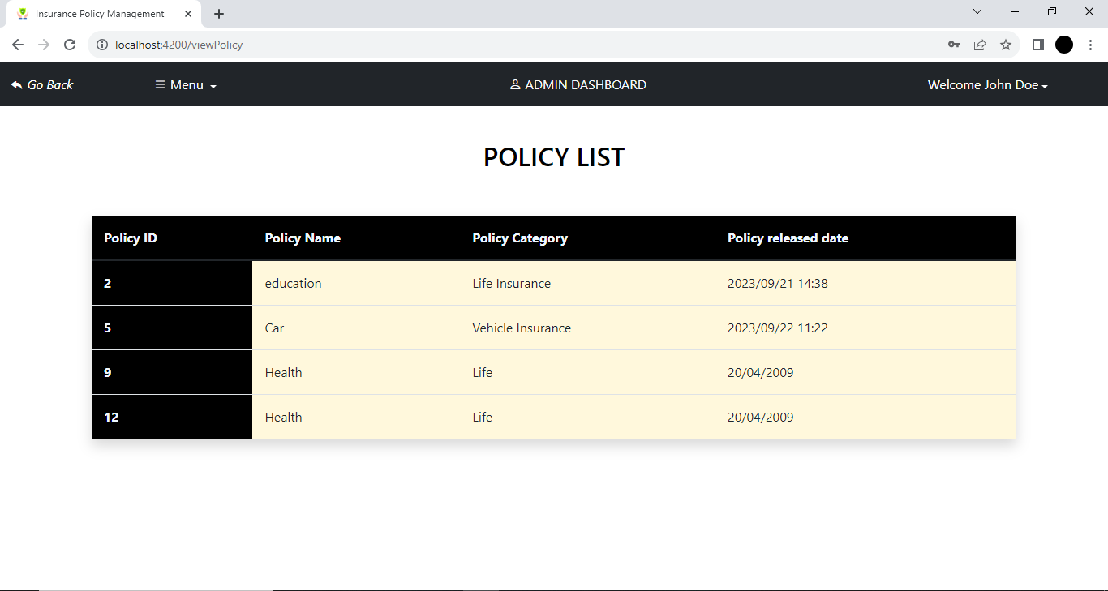
Policy List

Slide 29
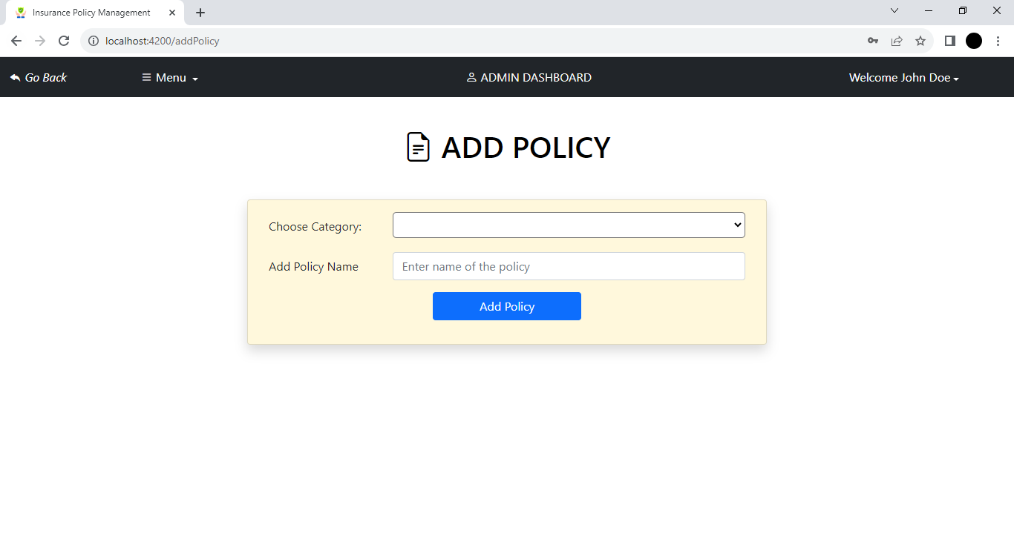
Add Policy

Slide 30
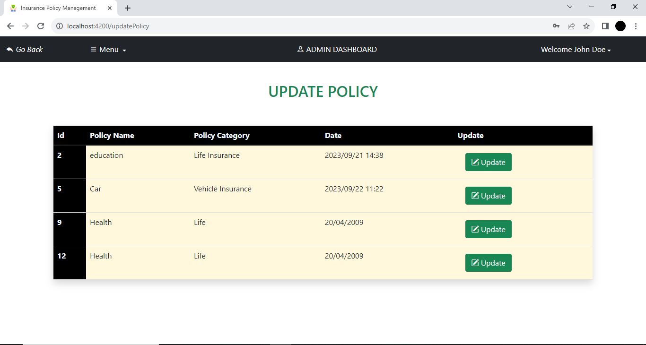
Update Policy

Slide 31
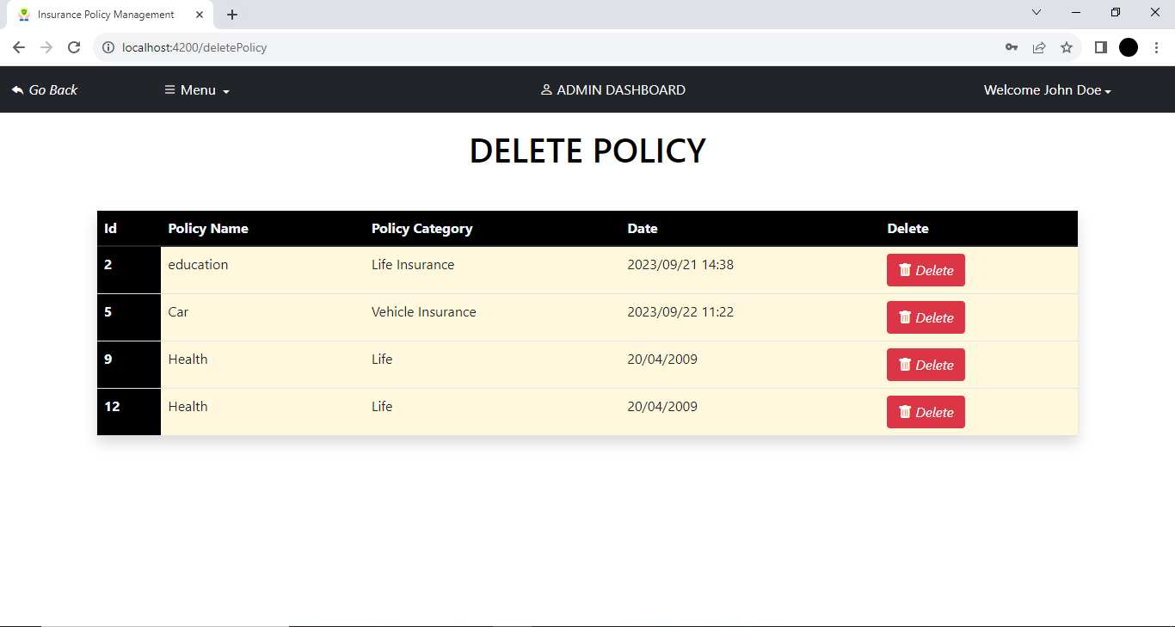
Delete Policy

Slide 32
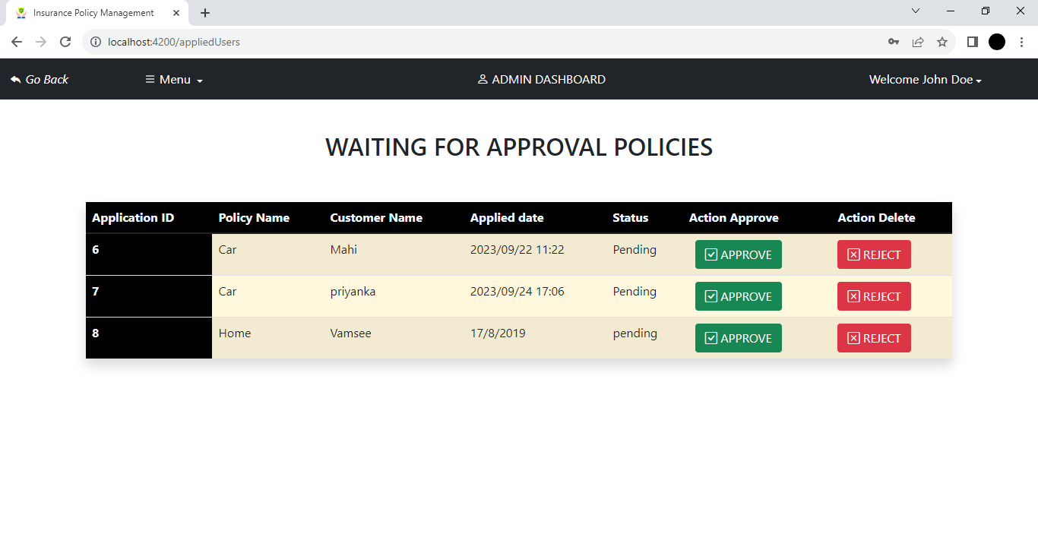
Waiting for Approval Policies

Slide 33
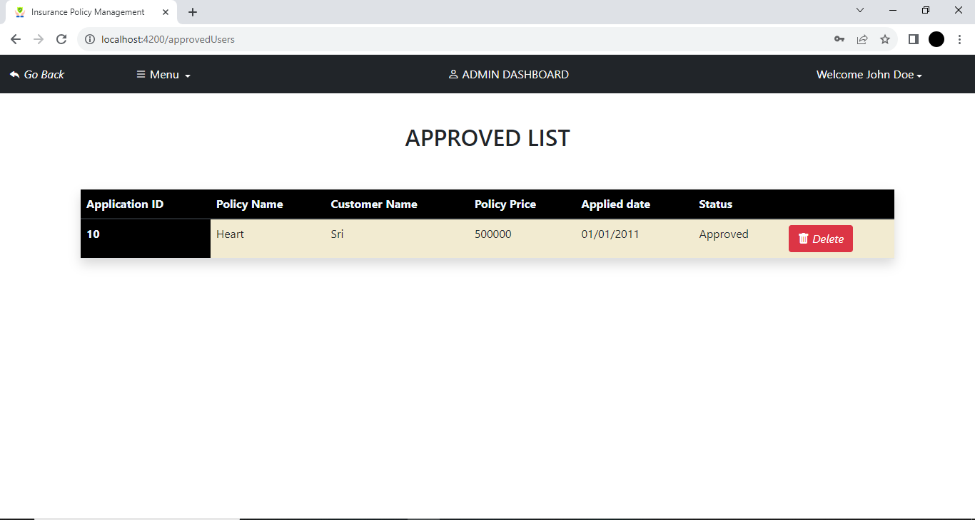
Approved List

Slide 34

Rejected List

Slide 35
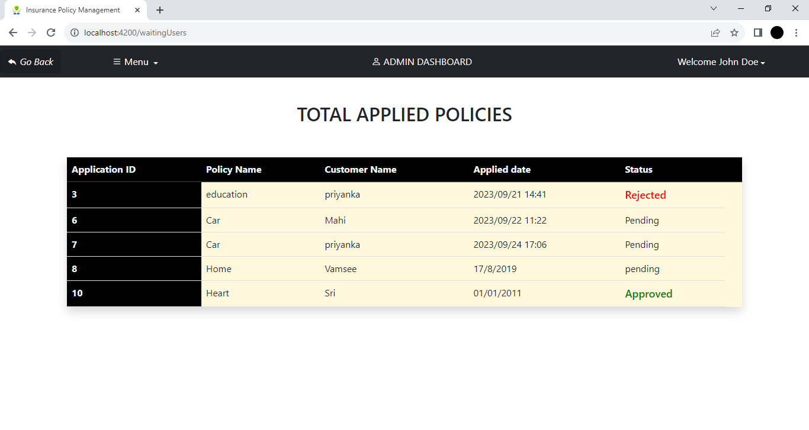
Total Applied Policies

Slide 36
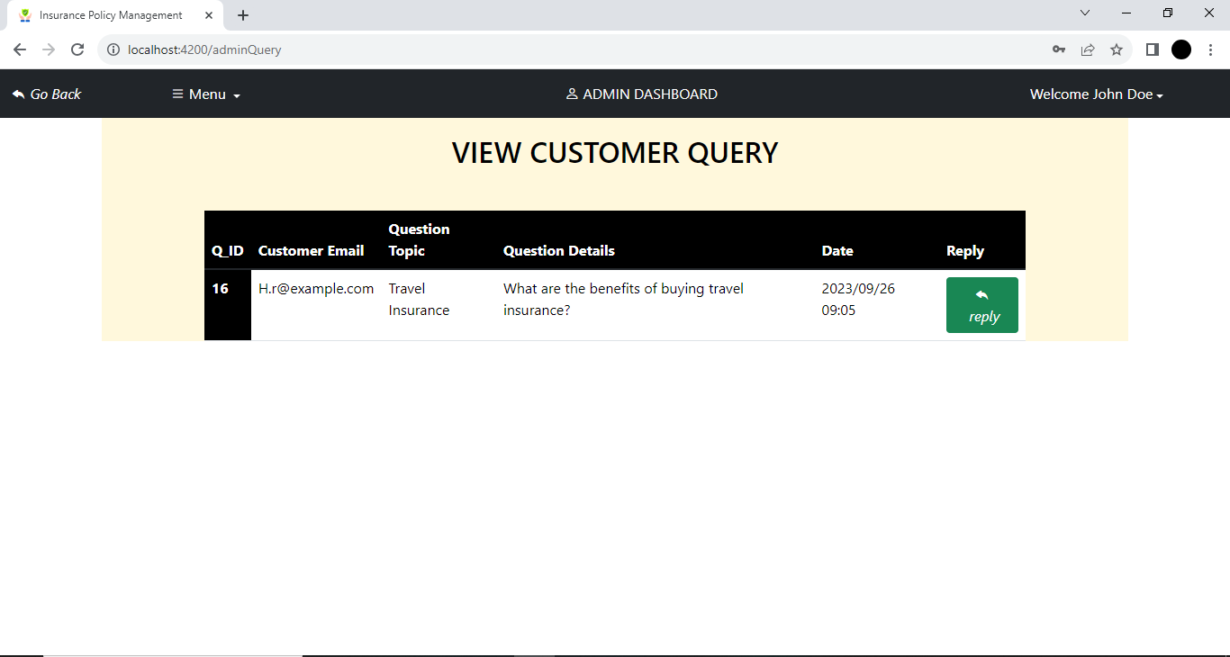
View Customer Query

Slide 37
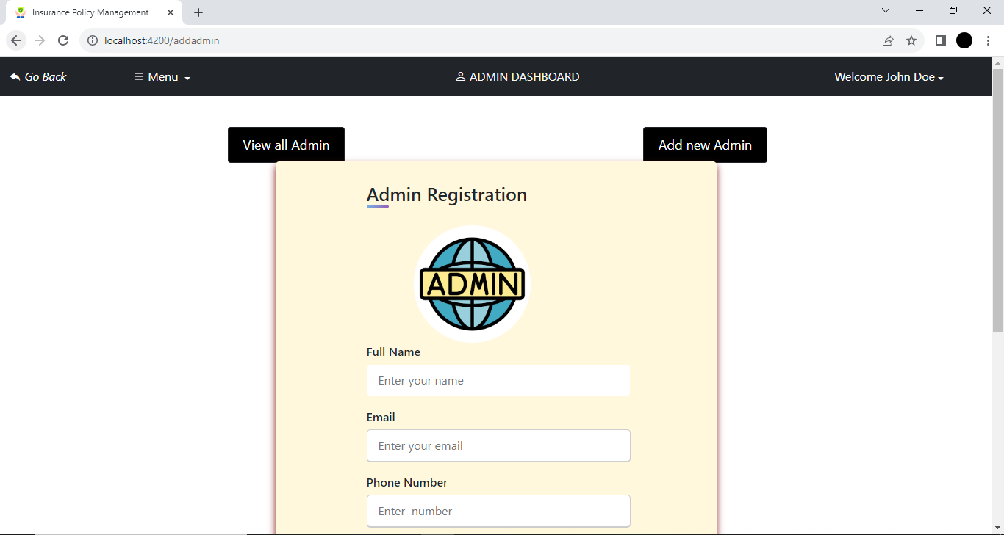
Add New Admin

Slide 38
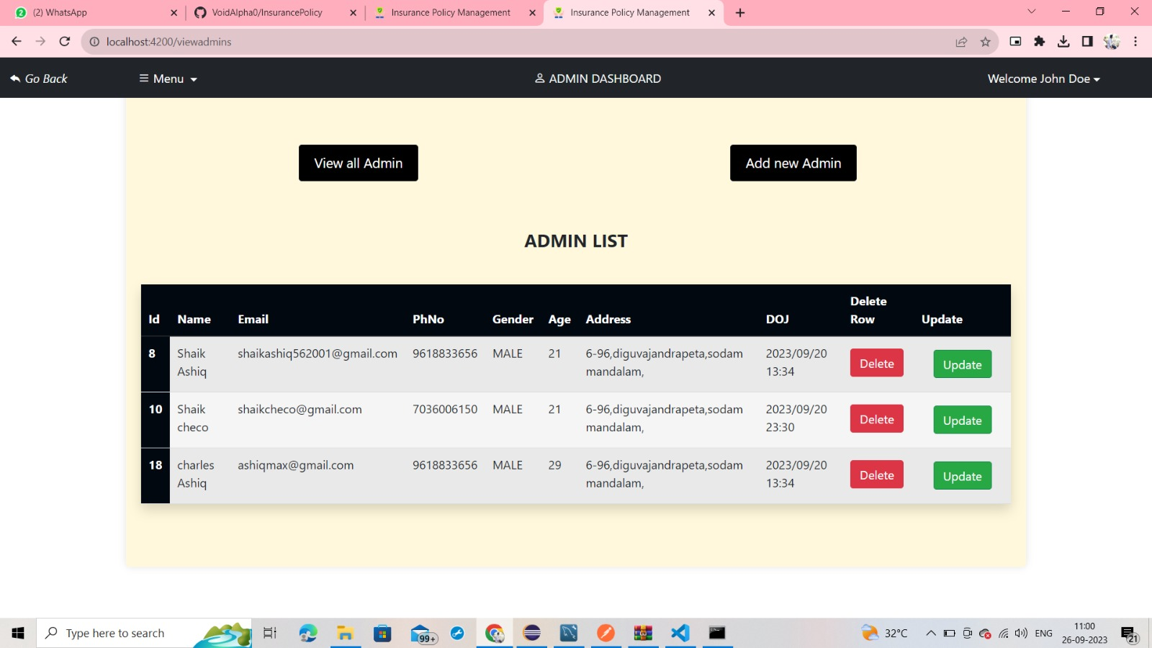
Admin List

Slide 39
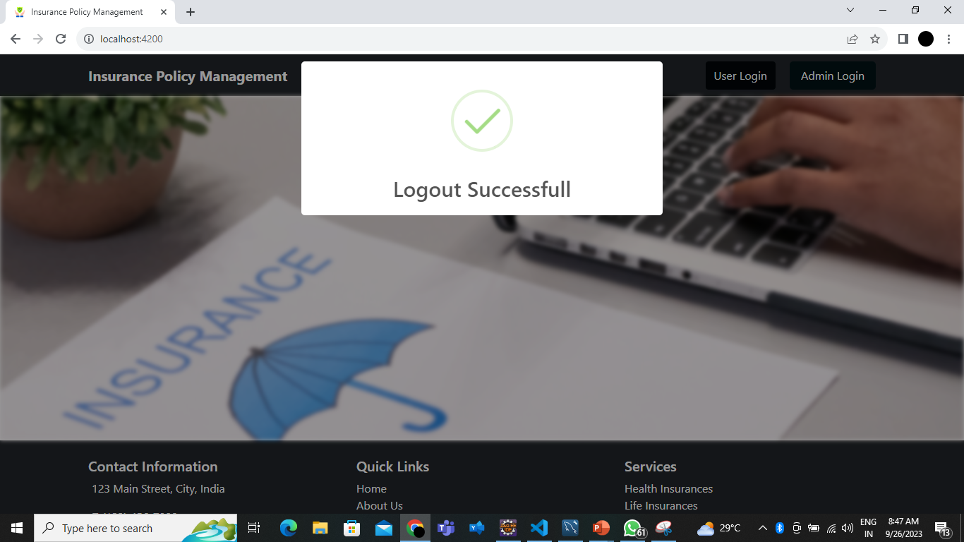
Admin Logout Successful

Slide 40
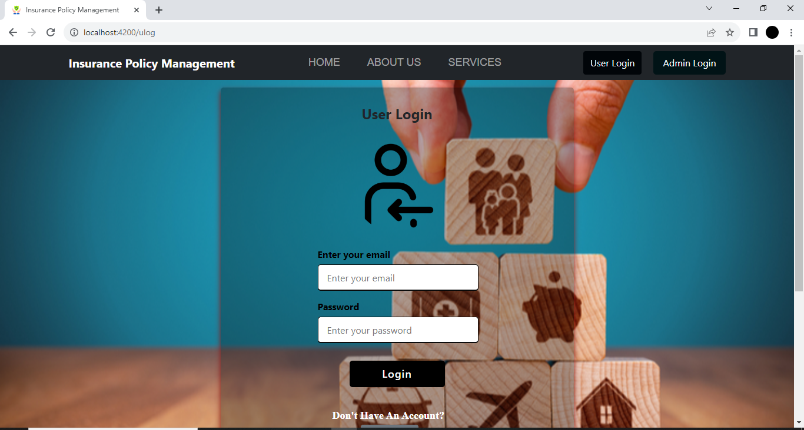
User Login Page

Slide 41
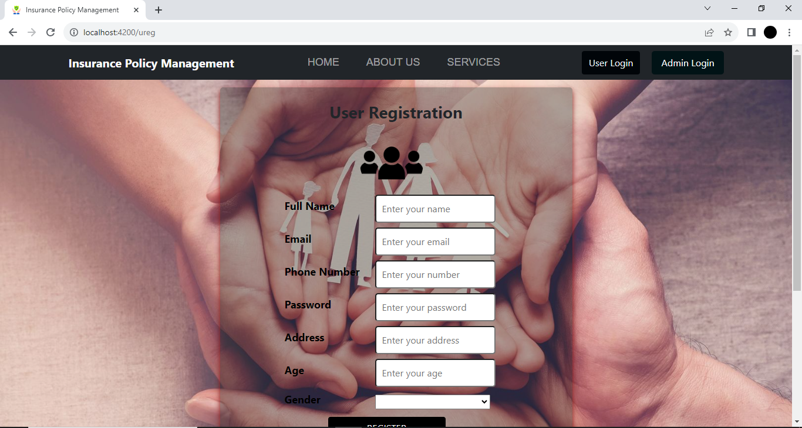
User Registration

Slide 42
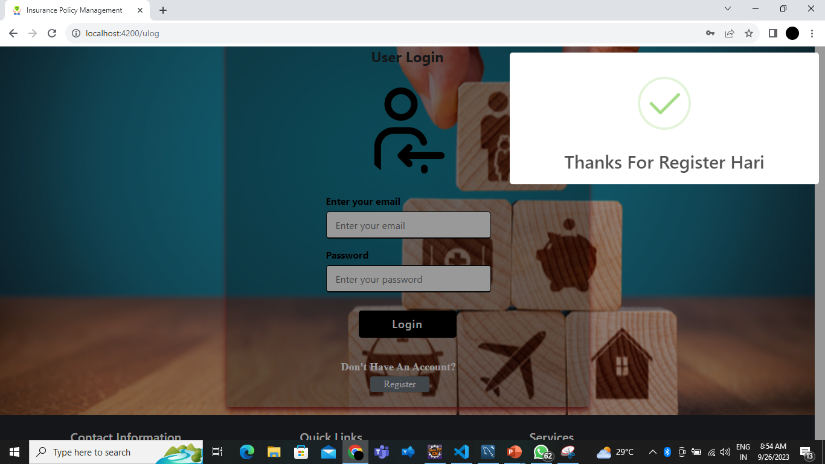
Registration Successful

Slide 43
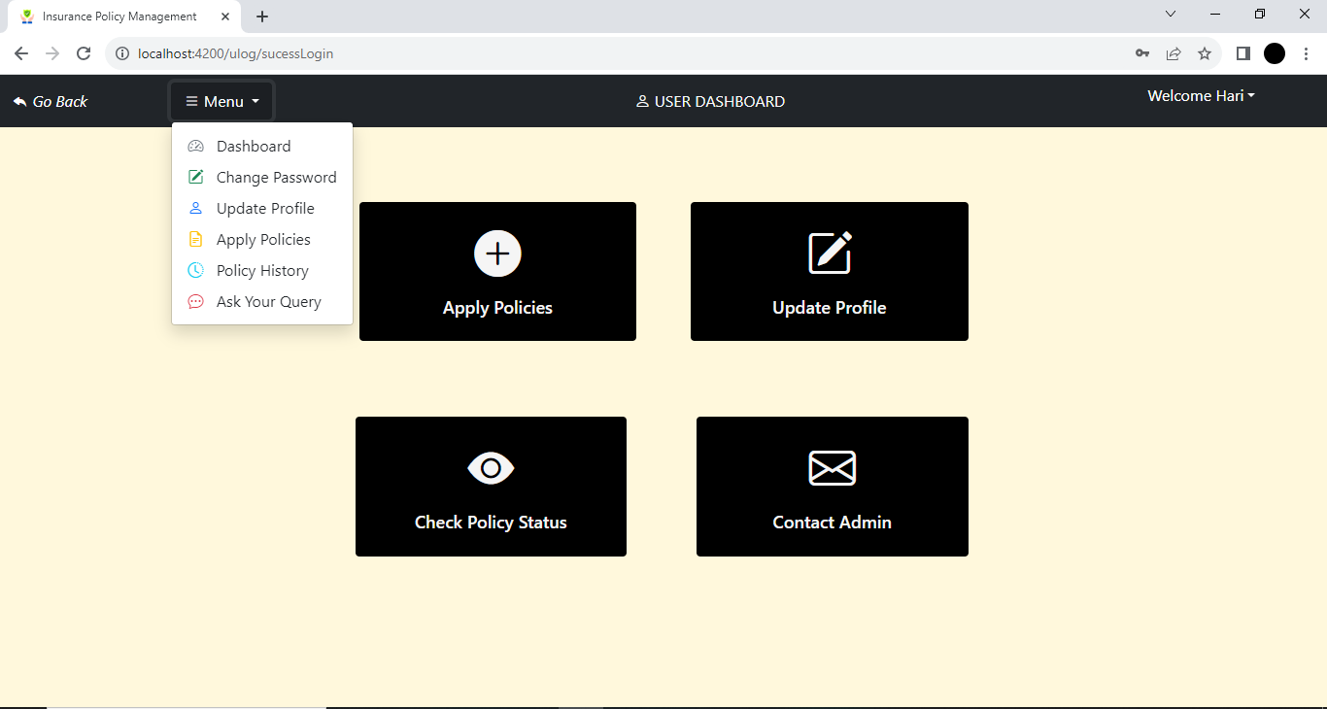
User Dashboard

Slide 44
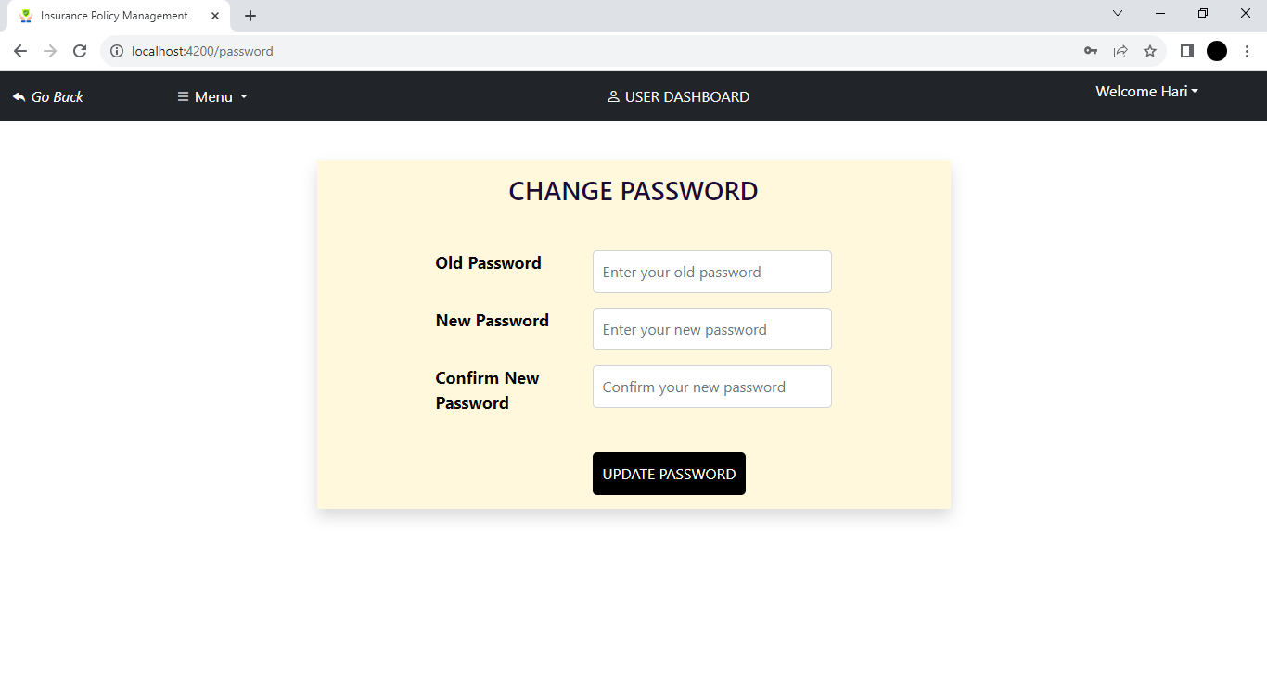
Change Password

Slide 45
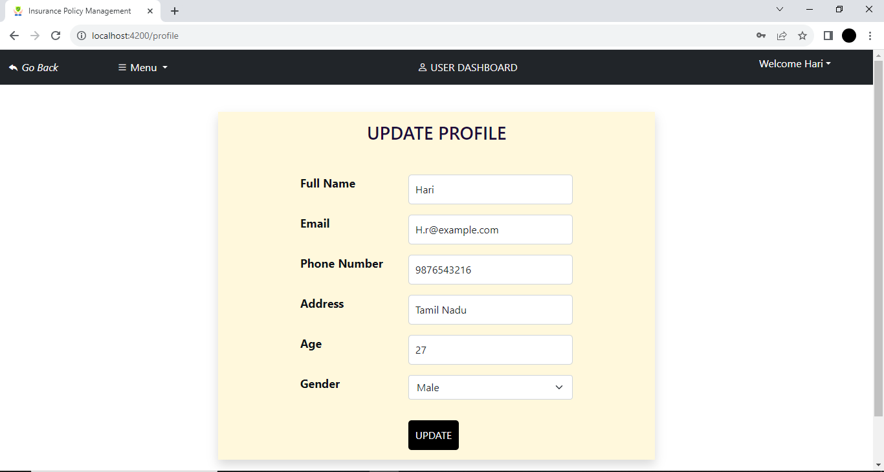
Update Profile

Slide 46
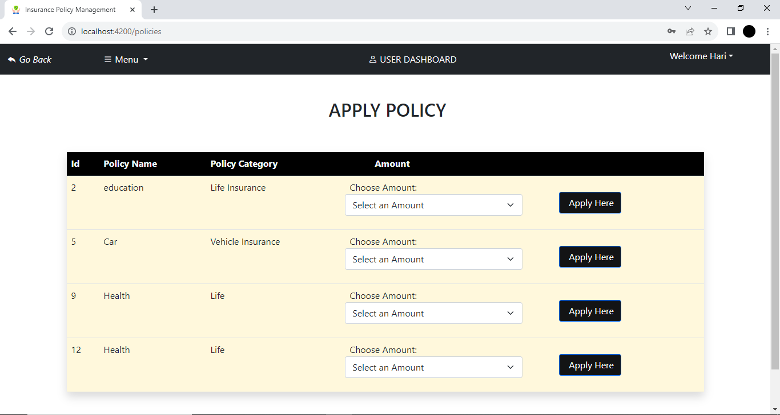
Apply Policy

Slide 47
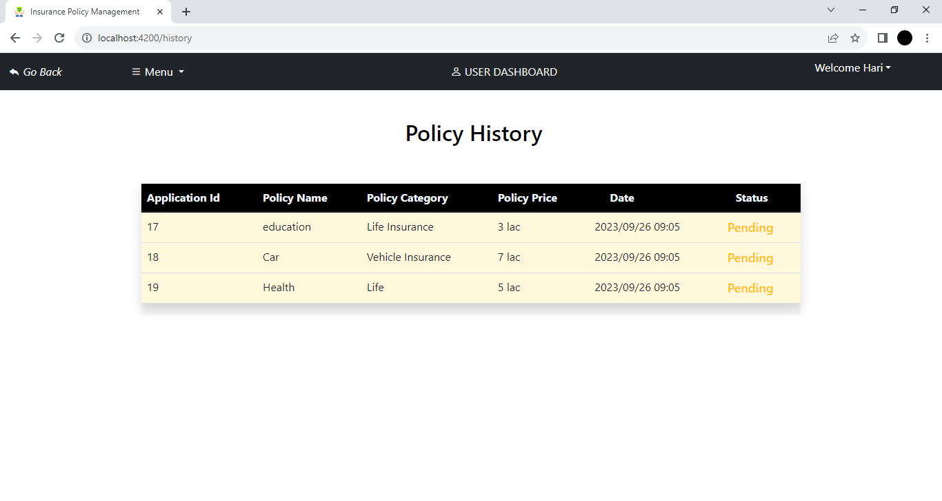
Policy History

Slide 48
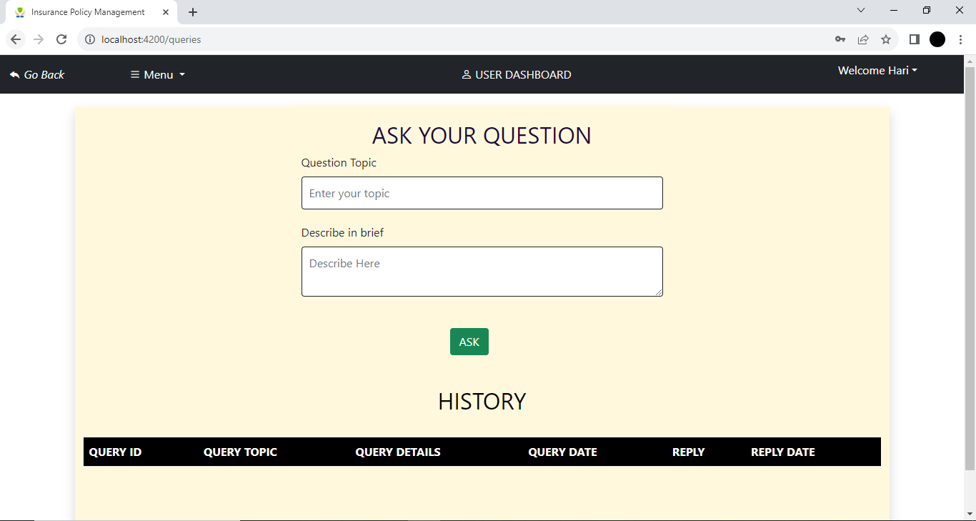
Questions Page

Slide 49
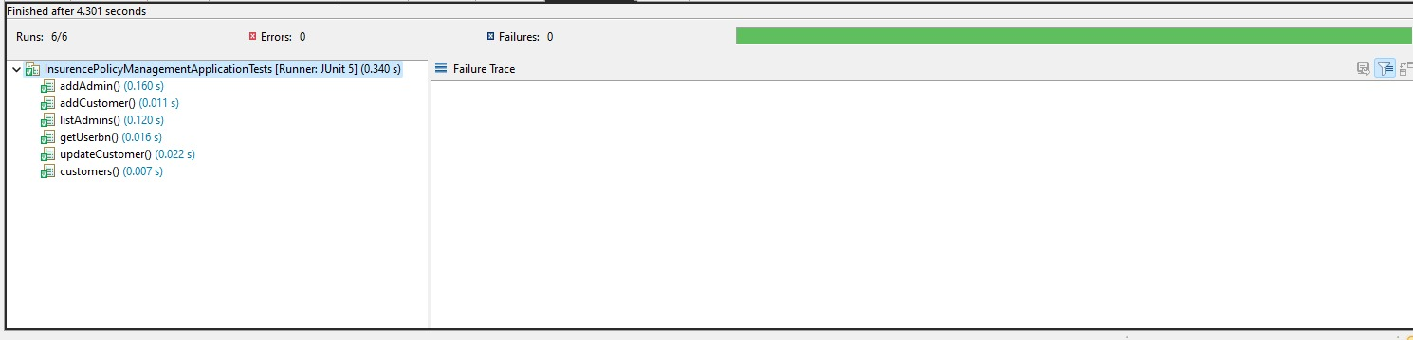
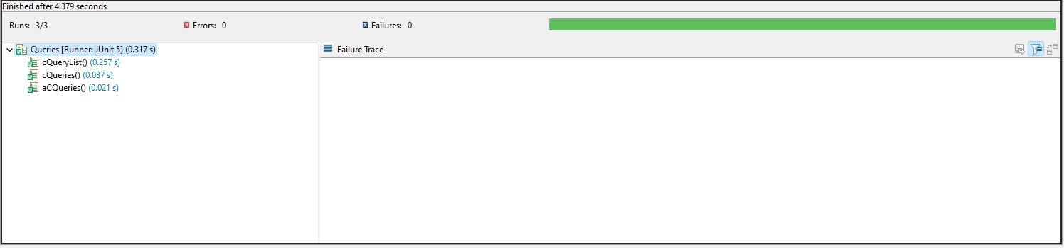
Junit Testing

Slide 50
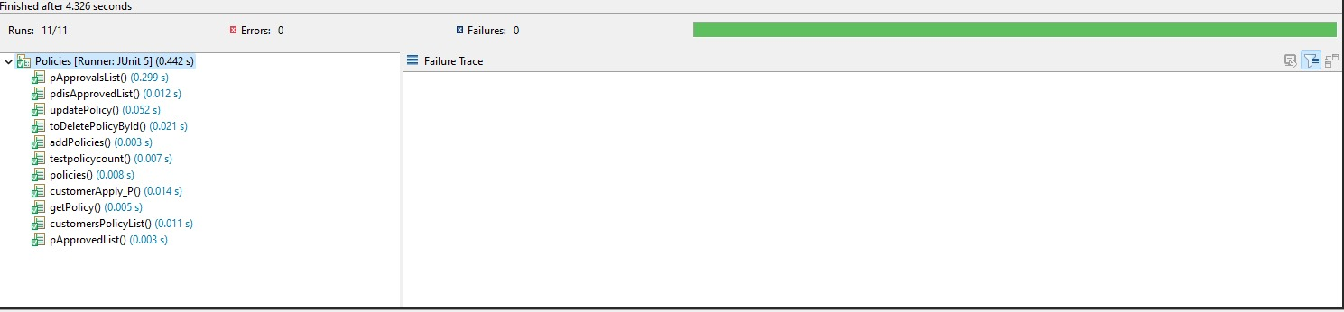
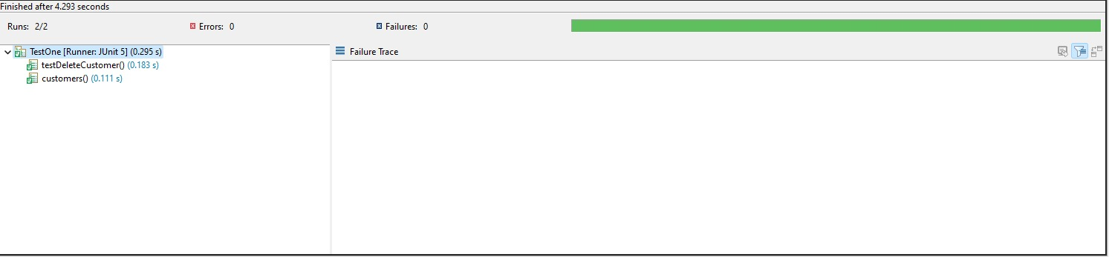
Junit Testing

Slide 51
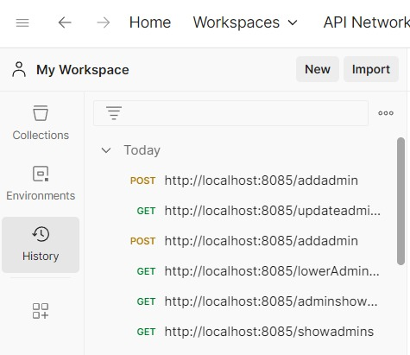
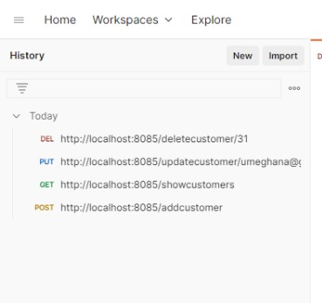
Postman

Slide 52
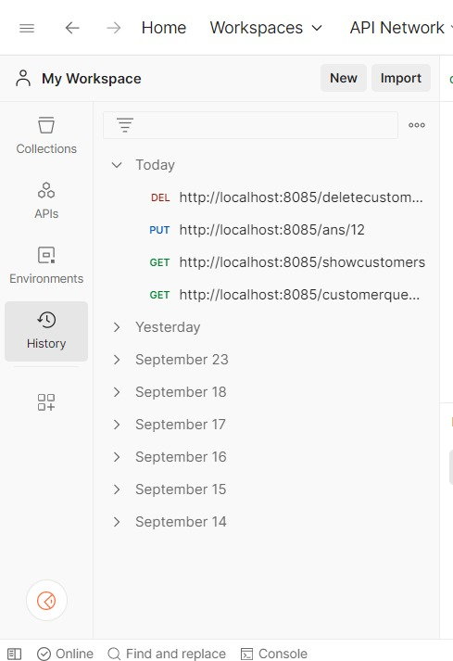
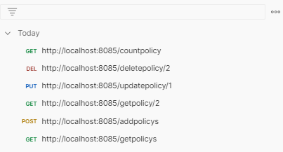
Postman

Slide 53
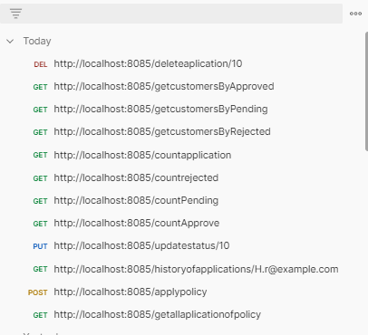
Postman

Slide 54
Advantages
The system helps maintain accurate and up-to-date records of policies and client information, reducing errors and improving data integrity.
Online services provide clients with 24/7 access to their policy information and services, increasing customer satisfaction.
The system offers a convenient and efficient way to manage insurance operations, saving time and effort for both the insurance company and its clients.
Automation and efficient record-keeping can lead to cost savings by reducing the need for manual data entry and paperwork.
The ability to create and edit policies easily allows for greater flexibility in serving the needs of both new and existing clients.

Slide 55
Future Scope
Add payment methods for our application.
The administrator can add and remove policy into the database on a weekly basis.
Promotional Emails.

Slide 56
Conclusion
Finally, this Insurance Policy Management System represents a significant advancement in the insurance industry, offering benefits to both insurance companies and their policyholders by simplifying and modernizing the insurance process.

Slide 57
THANK YOU

